Slide 1
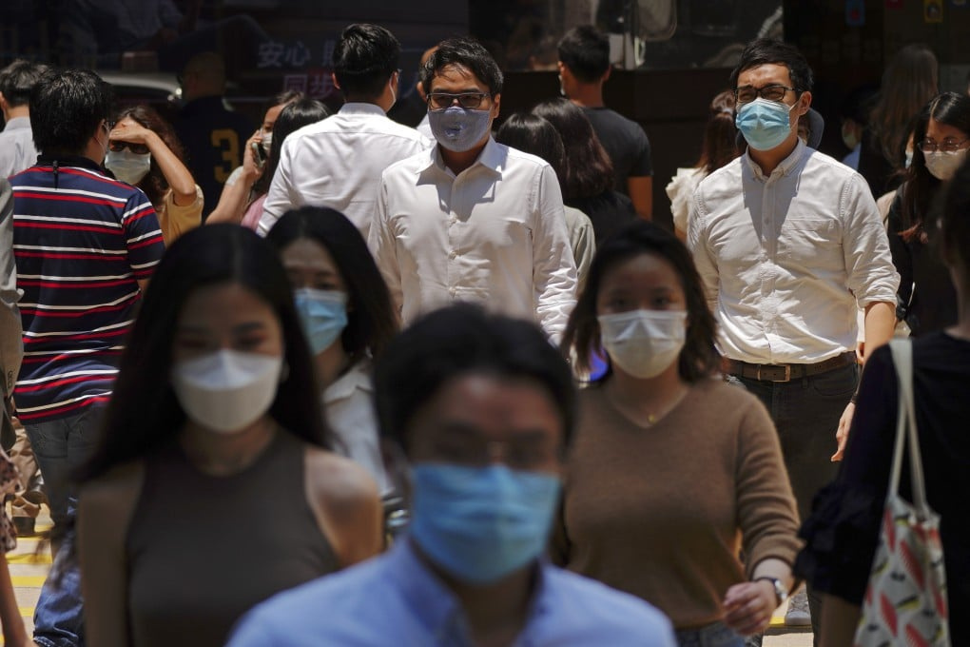
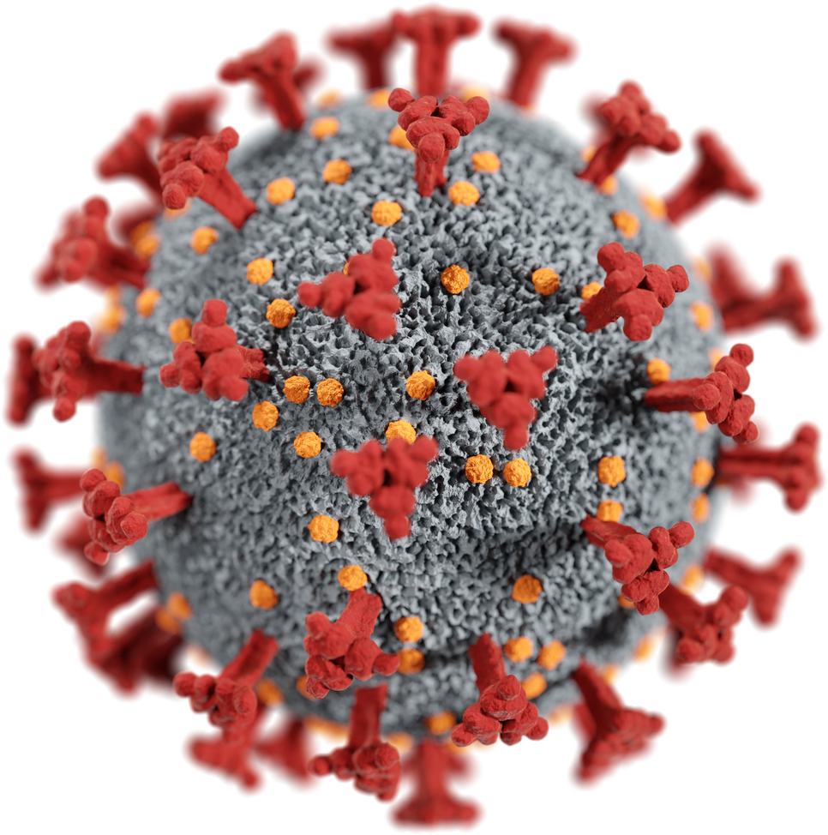
COVID 19

Slide 2

INTRODUCTION
COVID-19, a global pandemic caused by the SARS-CoV-2 virus. First detected in Wuhan, China in December 2019,COVID-19 spread rapidly worldwide, affecting millions and straining healthcare systems. The virus primarily spreads through respiratory droplets, causing symptoms like fever, cough, and shortness of breath.

Slide 3
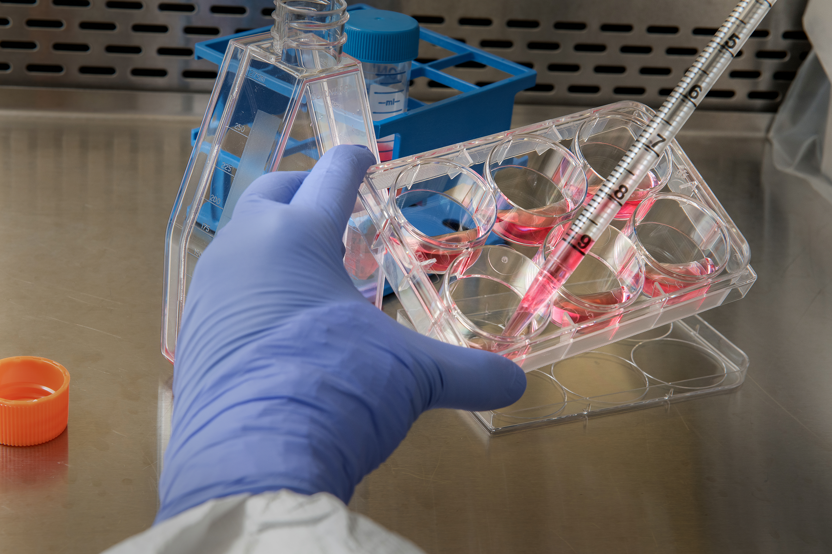

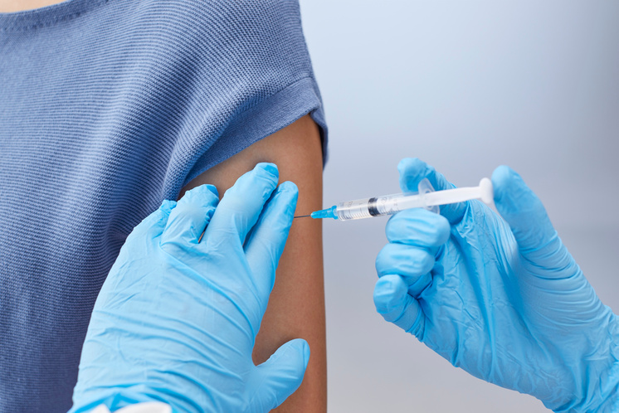

Mitigation:
Stay home if you're sick
Cover mouth and nose when coughing
Clean and disinfect surfaces regularly
Improve ventilation in indoor spaces
Follow local guidelines and restrictions
Prevention:
Get vaccinated
Wear a mask, especially in crowded areas
Practice social distancing (at least 1 meter apart)
Use hand sanitizer or wash hands frequently
Avoid touching face and eyes

Slide 4
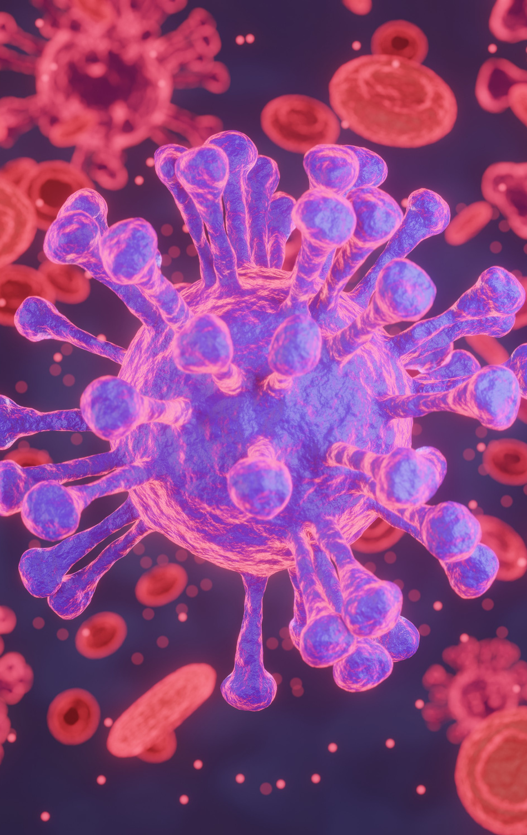
Covaxin is an inactivated COVID-19 vaccine developed by Bharat Biotech in collaboration with the Indian Council of Medical Research (ICMR) and National Institute of Virology (NIV). It's India's first indigenous COVID-19 vaccine and has been approved for emergency use in several countries

Slide 5
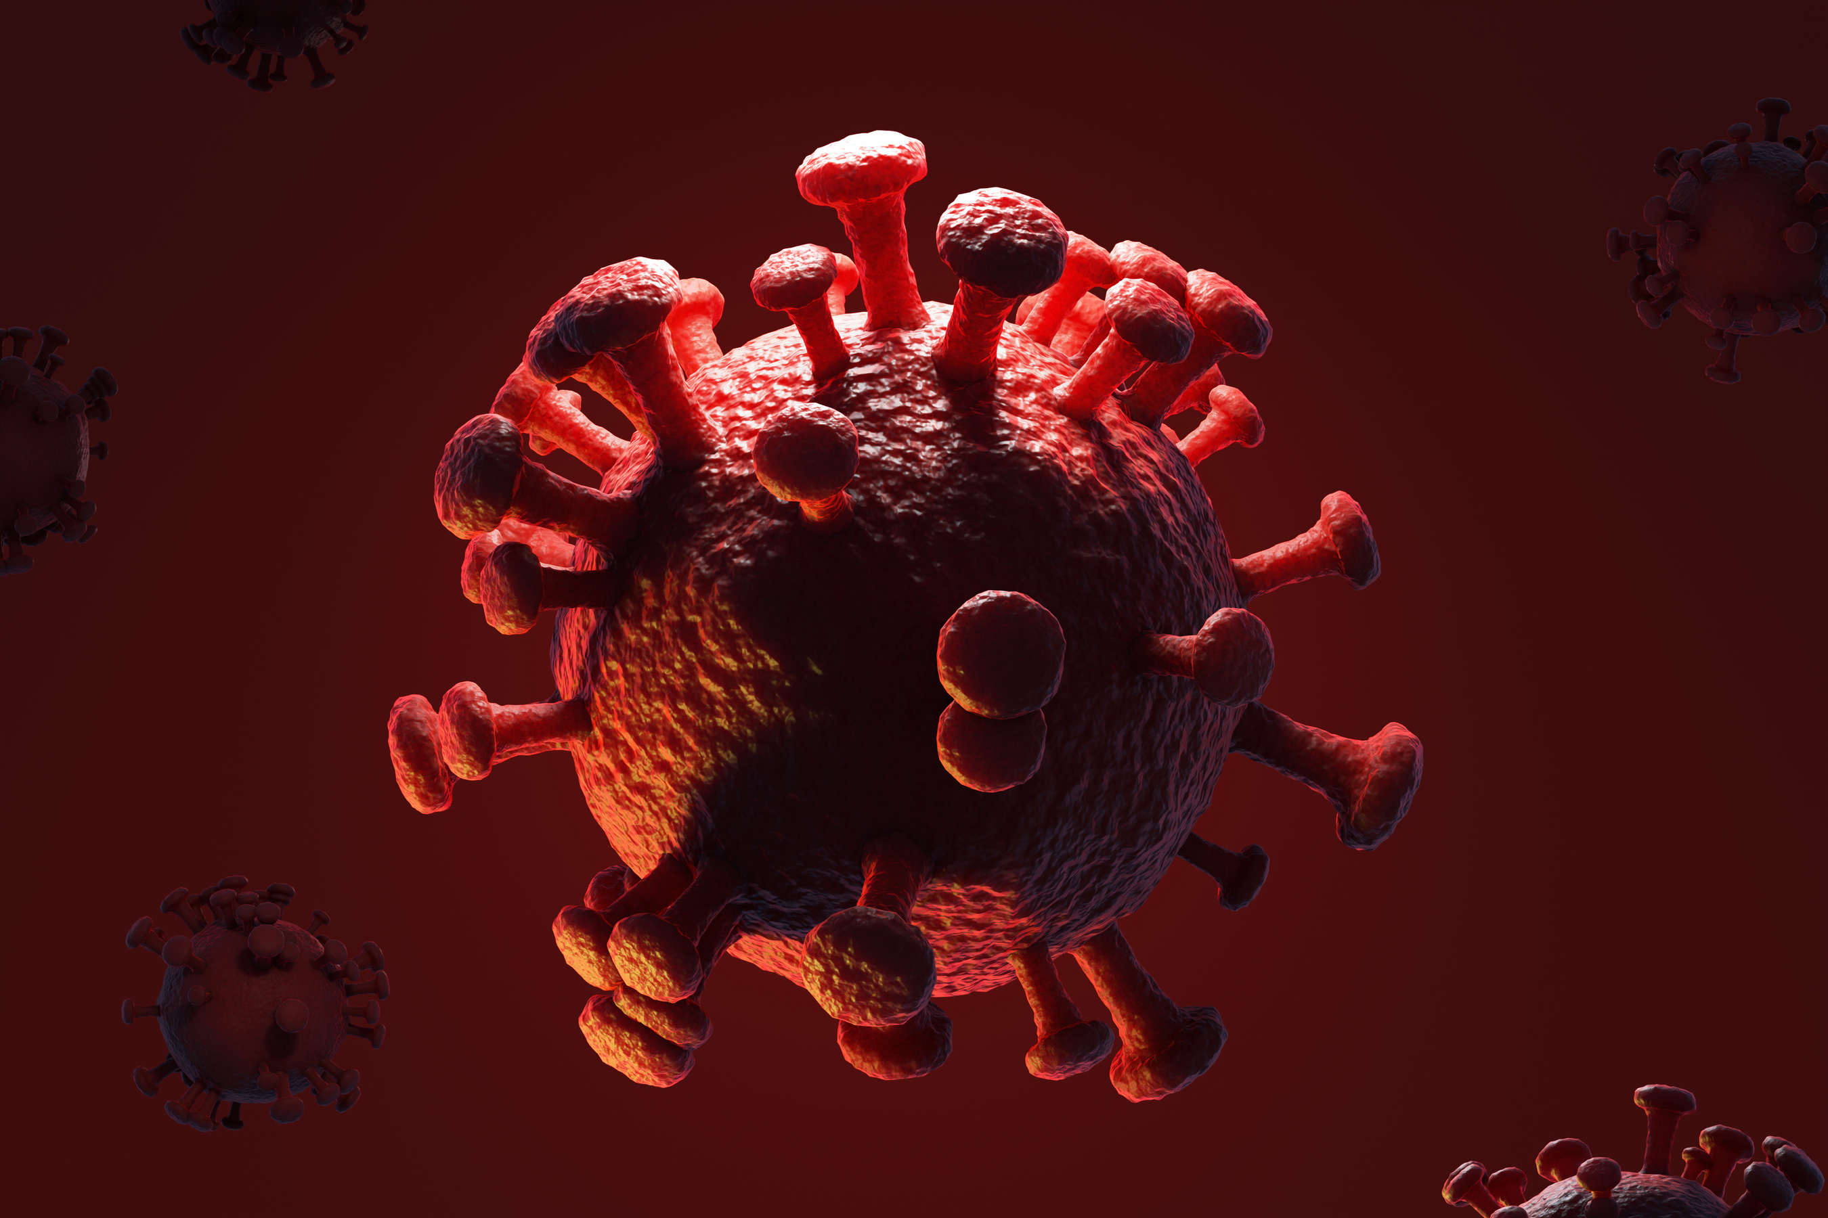

PREPAREDNESS
- Personal Preparedness:
- Vaccination
- Wearing masks
- Social distancing
- Hand hygiene
- Staying informed
- Community Preparedness:
- Testing and contact tracing
- Quarantine and isolation
- Vaccination drives
- Public awareness campaigns
- Healthcare Preparedness:
- Adequate PPE and equipment
- Trained healthcare workers
- ICU capacity and ventilators
- Emergency response plans

Slide 6

RESPONSE
Governments and health organizations worldwide implemented various measures to contain the outbreak. These included lockdowns, social distancing, and mask mandates to reduce transmission. Widespread testing and contact tracing helped identify and isolate cases. Vaccination drives have been instrumental in reducing severe cases and hospitalizations.

Slide 7

RECOVERY
Economic support packages have helped individuals and businesses survive. Mental health services are addressing the psychological impact of the pandemic. Healthcare systems are being strengthened to better prepare for future crises.

Slide 8


CONCLUSION
"In conclusion, COVID-19 has been a transformative global event, highlighting the importance of resilience, cooperation, and scientific innovation. As we navigate the post-pandemic era, prioritizing public health, supporting affected communities, and investing in healthcare infrastructure will be crucial for building a more resilient future."

Slide 9

TANK
YOU

